Slide 1

UECS3213 / UECS3453 Data Mining Topic 6: Association Analysis
Dr. Simon Lau Boung Yew

Slide 2
Course Learning Outcomes
CO1: Identify the key technological foundations of data mining
CO2: Create programming solutions using data mining techniques for given problem
CO3: Evaluate performance of data mining solutions for a given problem
CO4: Construct a data mining project as a team
CO5: Recognize the importance of data mining techniques and its applications in the industry

Slide 3
Outline
Market Basket Analysis
Association Rule Mining
Definition
Association Rule Mining Task
Mining Association Rules
Apriori Algorithm

Slide 4
Market Basket Analysis
Market Basket Analysis is one of the key techniques used by large retailers to uncover associations between items.
It works by looking for combinations of items that occur together frequently in transactions.
To put it another way, it allows retailers to identify relationships between the items that people buy.
Notes:
https://towardsdatascience.com/a-gentle-introduction-on-market-basket-analysis-association-rules-fa4b986a40ce

Slide 5
The Market-Basket Problem
Given a database of transactions where each transaction is a collection of items (purchased by a customer in a visit)
find all rules that correlate the presence of one set of items with that of another set of items
Example:
30% of all transactions that contain diapers also contain beers: {diaper} --> {beer}
5% of all transactions contain these items: {diaper, beer}
30%: confidence of the rule c({diaper} --> {beer}) = 0.30
5%: support of the rule
We are interested in finding all rules, rather than verifying that a particular rule holds

Slide 6
Applications of Market-Basket Analysis
Supermarkets
Placement
Advertising
Sales
Coupons
Many applications outside market basket data analysis
Prediction (telecom switch failure)
Web usage mining
Many different types of association rules
Temporal
Spatial
Causal

Slide 7
Association Rule Mining / Learning
Given a set of transactions, find rules that will predict the occurrence of an item based on the occurrences of other items in the transaction (association).
Market-Basket transactions
Example of Association Rules
{Diaper} → {Beer}, {Milk, Bread} → {Eggs,Coke}, {Beer, Bread} → {Milk},
Implication means co-occurrence, not causality 因果关系.
Notes:
Causality: the relationship between cause and effect.
https://en.wikipedia.org/wiki/Association_rule_learning

Slide 8
Definition: Itemset, Support Count
Itemset
A collection of one or more items
Example: {Milk, Bread, Diaper}
k-itemset
An itemset that contains k items
Support count (σ)
Frequency of occurrence of an itemset
E.g. σ({Milk, Bread, Diaper}) = 2

Slide 9
Definition: Support, Frequent Itemset
Support, s
Fraction of transactions that contain an itemset
E.g. s({Milk, Bread, Diaper}) = 2/5
Frequent Itemset
An itemset whose support is greater than or equal to a minimum support (minsup) threshold

Slide 10
Definition: Association Rule
Association Rule
An implication expression of the form X → Y, where X and Y are itemsets
Example: {Milk, Diaper} → {Beer}
Rule Evaluation Metrics
Support (s)
Fraction of transactions that contain both X and Y
Confidence (c)
Measures how often items in Y appear in transactions that contain X
Example:

Slide 11
Aspects of Association Rule Mining
How do we generate rules fast?
Performance measured in
Number of database scans
Number of itemsets that must be counted
Which are the interesting rules?

Slide 12
Mining Association Rules
Two-step approach:
Frequent Itemset Generation (compute support)
Generate all itemsets whose support ≥ minsup (frequent itemset)
Rule Generation (compute confidence)
Generate high confidence rules from each frequent itemset
Given a set of transactions T, the goal of association rule mining is to find all rules having
support ≥ minsup (generate frequent itemset)
confidence ≥ minconf (generate rule)

Slide 13
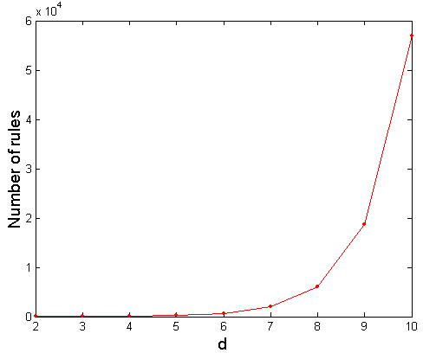
Computational Complexity
Given d unique items:
Total number of itemsets = 2^{d}
Total number of possible association rules:
If d=6, R = 602 rules (exponential)
Notes:
Total number of association rules: R = 3^{d} + 2^{d+1} + 1
where d = number of items
https://people.revoledu.com/kardi/tutorial/MarketBasket/AssociationRules.htm

Slide 14
How many association rules? Brute-force approach
List all possible association rules
Compute the support and confidence for each rule
Prune (delete) rules that fail the minsup and minconf thresholds
⇒ Computationally prohibitive (too expensive)!

Slide 15
Brute-force algorithm for finding all frequent itemsets
Possible itemset: candidate set
(Support)

Slide 16
Step 1: Frequent Itemset Generation How many itemsets are there?
Lattice of itemsets
If minsup = 0, then all subsets will be frequent and thus the size of the collection will be very large
The task of finding all frequent sets is interesting typically only for relatively large values of minsup (unique & rare associations)

Slide 17
Step 1: Frequent Itemset Generation
Brute-force approach:
Each itemset in the lattice is a candidate frequent itemset
Count the support of each candidate by scanning the database
Match each transaction against every candidate
Complexity ~ O(NMw) => Expensive since M = 2^{d} !!! (next slide)
From the
lattice

Slide 18
Frequent Itemset Generation Strategies
Reduce the number of candidates (M)
Complete search: M=2^{d}
Use pruning techniques to reduce M (prune the supersets of itemsets which are not supported)
Reduce the number of transactions (N)
Reduce size of N as the size of itemset increases
Used by Direct Hashing and Pruning (DHP) and vertical-based mining algorithms
Reduce the number of comparisons (NM)
Use efficient data structures to store the candidates or transactions
No need to match every candidate against every transaction (brute force)
Notes:
https://www.iasj.net/iasj?func=fulltext&aId=41181
http://user.it.uu.se/~kostis/Teaching/DM-05/Slides/association2.pdf

Slide 19
Mining Association Rules
Example of Rules:
{Milk, Diaper} → {Beer} (s=2/5=0.4, c=2/3=0.67)
{Milk, Beer} → {Diaper} (s=2/5=0.4, c=2/2=1.0)
{Diaper, Beer} → {Milk} (s=2/5=0.4, c=2/3=0.67)
{Beer} → {Milk, Diaper} (s=2/5=0.4, c=2/3=0.67)
{Diaper} → {Milk, Beer} (s=2/5=0.4, c=2/4=0.5)
{Milk} → {Diaper, Beer} (s=2/5=0.4, c=2/4=0.5)
Observations:
All the above rules are binary partitions of the same itemset: {Milk, Diaper, Beer}
Rules originating from the same itemset have identical support but can have different confidence
Thus, we may decouple (separate) the support and confidence requirements

Slide 20
Reducing Number of Candidates: Aprior Principle
Apriori principle:
If an itemset is frequent, then all of its subsets must also be frequent
Apriori principle holds due to the following property of the support measure:
Support of an itemset never exceeds the support of its subsets
Example: s({a}) ≥ s({a, b})
This is known as the anti-monotone property of support
Notes:
https://en.wikipedia.org/wiki/A_priori_and_a_posteriori
http://simpledatamining.blogspot.com/2015/02/apriori-principle_17.html

Slide 21
Illustrating Apriori Principle
Found to be Infrequent
If AB is not supported (not frequent), all supersets containing “AB” as a subsequence is also not supported.
Pruned supersets

Slide 22
Illustrating Apriori Principle
Items (1-itemsets)
6 items, k = 1, 2, 3
Minimum Support = 3
Brute force: If every subset is considered (brute-force),
⁶C₁ + ⁶C₂ + ⁶C₃
6 + 15 + 20 = 41
With support-based pruning,
6 + 6 + 4 = 16

Slide 23
Illustrating Apriori Principle
Items (1-itemsets)
Minimum Support = 3
If every subset is considered,
⁶C₁ + ⁶C₂ + ⁶C₃
6 + 15 + 20 = 41
With support-based pruning,
6 + 6 + 4 = 16
Compute support for all 1-itemset before pruning
Coke and Eggs (s < 3)
⁶C₁

Slide 24
Illustrating Apriori Principle
Items (1-itemsets)
Pairs (2-itemsets)
(Pruning: No need to generate candidates involving Coke or Eggs)
Minimum Support = 3
If every subset is considered,
⁶C₁ + ⁶C₂ + ⁶C₃
6 + 15 + 20 = 41
With support-based pruning,
6 + 6 + 4 = 16

Slide 25
Illustrating Apriori Principle
Items (1-itemsets)
Pairs (2-itemsets)
(No need to generate candidates involving Coke or Eggs)
Minimum Support = 3
If every subset is considered,
⁶C₁ + ⁶C₂ + ⁶C₃
6 + 15 + 20 = 41
With support-based pruning,
6 + 6 + 4 = 16
⁴C₂

Slide 26
Illustrating Apriori Principle
Items (1-itemsets)
Pairs (2-itemsets)
(No need to generate candidates involving Coke or Eggs)
Minimum Support = 3
Triplets (3-itemsets)
If every subset is considered,
⁶C₁ + ⁶C₂ + ⁶C₃
6 + 15 + 20 = 41
With support-based pruning,
6 + 6 + 4 = 16
⁴C₃

Slide 27
Illustrating Apriori Principle
Items (1-itemsets)
Pairs (2-itemsets)
(No need to generate candidates involving Coke or Eggs)
Minimum Support = 3
Triplets (3-itemsets)
If every subset is considered,
⁶C₁ + ⁶C₂ + ⁶C₃
6 + 15 + 20 = 41
With support-based pruning,
6 + 6 + 4 = 16
6 + 6 + 1 = 13
¹C₁

Slide 28
Apriori Algorithm
support < minsup

Slide 29
Apriori Algorithm
Given:
F_{k}: frequent k-itemsets
L_{k}: candidate list of k-itemsets
Let k=1
Generate F₁ = {frequent 1-itemsets}
Repeat until F_{k} is empty
Candidate Generation: Generate L_{k+1} from F_{k}
Candidate Pruning: Prune candidate itemsets in L_{k+1} containing subsets of length k that are infrequent
Support Counting: Count the support of each candidate in L_{k+1} by scanning the DB
Candidate Elimination: Eliminate candidates in L_{k+1} that are infrequent, leaving only those that are frequent => F_{k+1}

Slide 30
Example: Apriori Algorithm (minsup = 2)
F₁
F₂
Pruning
s(1 2 3) = 1
s(1 3 5) = 1
s(2 3 5) = 2

Slide 31
1. Candidate Generation: F_{k-1} x F_{k-1} Method
Merge two frequent (k-1)-itemsets if their first (k-2) items are identical
F₃ = {ABC,ABD,ABE,ACD,BCD,BDE,CDE}
F₄ = Merge(ABC, ABD) = ABCD
F₄ = Merge(ABC, ABE) = ABCE
F₄ = Merge(ABD, ABE) = ABDE
Do not merge(ABD,ACD) because they share only prefix of length 1 instead of length 2

Slide 32
1. Candidate Generation: Alternate F_{k-1} x F_{k-1} Method
Merge two frequent (k-1)-itemsets if the last (k-2) items of the first one is identical to the first (k-2) items of the second.
F₃ = {ABC,ABD,ABE,ACD,BCD,BDE,CDE}
Merge(ABC, BCD) = ABCD
Merge(ABD, BDE) = ABDE
Merge(ACD, CDE) = ACDE
Merge(BCD, CDE) = BCDE

Slide 33
2. Candidate Pruning
Let F₃ = {ABC,ABD,ABE,ACD,BCD,BDE,CDE} be the set of frequent 3-itemsets
L₄ = {ABCD, ABCE, ABDE} is the set of candidate 4-itemsets generated (from previous slide)
Candidate pruning
Prune ABCE because ACE and BCE are infrequent
Prune ABDE because ADE is infrequent
After candidate pruning: L₄ = {ABCD}

Slide 34
2. Candidate Pruning for Alternate F_{k-1} x F_{k-1} Method
Let F₃ = {ABC,ABD,ABE,ACD,BCD,BDE,CDE} be the set of frequent 3-itemsets
L₄ = {ABCD,ABDE, ACDE, BCDE} is the set of candidate 4-itemsets generated (from previous slide)
Candidate pruning
Prune ABDE because ADE is infrequent
Prune ACDE because ACE and ADE are infrequent
Prune BCDE because BCE is infrequent
After candidate pruning: L₄ = {ABCD} (both methods lead to the same L₄)

Slide 35
Example: Candidate Generation & Pruning: Method 1: L_{k+1} = Merge F_{k-1} and F₁ itemsets
L_{k+1}

Slide 36
Example: Candidate Generation & Pruning: Method 2: L_{k+1} = F_{k-1} x F_{k-1} Method
L_{k+1}

Slide 37
Illustrating Apriori Principle
Items (1-itemsets)
Pairs (2-itemsets)
(No need to generate candidates involving Coke or Eggs)
Minimum Support = 3
Triplets (3-itemsets)
If every subset is considered,
⁶C₁ + ⁶C₂ + ⁶C₃
6 + 15 + 20 = 41
With support-based pruning,
6 + 6 + 1 = 13
Use of F_{k-1}xF_{k-1} method for candidate generation results in
only one 3-itemset. This is eliminated after the support counting step.

Slide 38
3. Support Counting of Candidate Itemsets
Support counting is the process of scanning the database to determine the frequency of occurrence for every candidate itemset that survives the candidate pruning step of the apriori-gen function.
Must match every candidate itemset against every transaction, which is an expensive operation

Slide 39
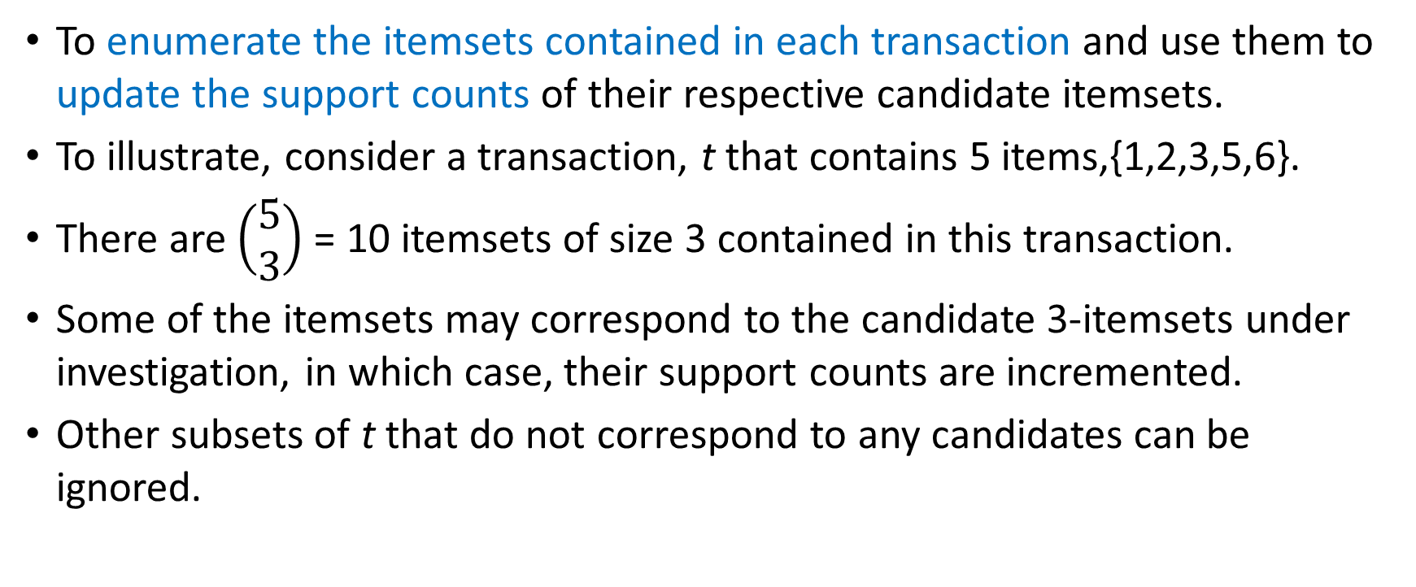
3. Support Counting of Candidate Itemsets: Alternative Approach
To enumerate the itemsets contained in each transaction and use them to update the support counts of their respective candidate itemsets.
To illustrate, consider a transaction, t that contains 5 items,{1,2,3,5,6}.
There are $\left(\begin{aligned}5 \\ 3\end{aligned}\right)$ = 10 itemsets of size 3 contained in this transaction.
Some of the itemsets may correspond to the candidate 3-itemsets under investigation, in which case, their support counts are incremented.
Other subsets of t that do not correspond to any candidates can be ignored.
Notes:
https://www-users.cs.umn.edu/~kumar001/dmbook/ch6.pdf

Slide 40
The Hash Tree Structure
Create a dictionary (hash table) that stores the candidate itemsets as keys, and the number of appearances (support) as the value.
Suppose you have 15 candidate itemsets of length 3: {1 4 5}, {1 2 4}, {4 5 7}, {1 2 5}, {4 5 8}, {1 5 9}, {1 3 6}, {2 3 4}, {5 6 7}, {3 4 5}, {3 5 6}, {3 5 7}, {6 8 9}, {3 6 7}, {3 6 8}
Hash table stores the counts of the candidate itemsets as they have been computed so far

Slide 41
The Hash Tree Structure

Slide 42
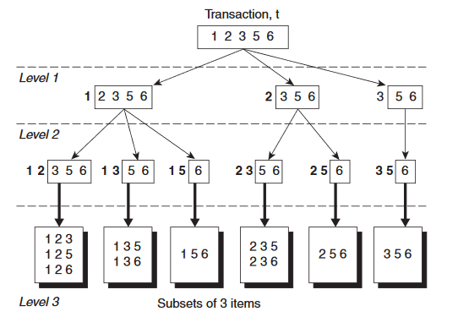
3. Support Counting of Candidate Itemsets: Subset Generation
Given a transaction t, what are the possible subsets of size 3?
Recursively
Tuple {1,2,3,5,6} generates the following itemsets of length 3:
{1 2 3}, {1 2 5}, {1 2 6}, {1 3 5}, {1 3 6}, {1 5 6}, {2 3 5}, {2 3 6}, {2 5 6}, {3 5 6}

Slide 43
Subset Operation Using Hash Tree

Slide 44
3. Support Counting of Candidate Itemsets: Support Counting
Next, we have to determine whether each enumerated 3-itemset corresponds to an existing candidate itemset.
Increment the counters for the itemsets in the dictionary

Slide 45
Support Counting of Candidate Itemsets
For more detail, read http://www.cs.uoi.gr/~tsap/teaching/2012f-cs059/material/datamining-lect3.pdf

Slide 46
4. Rule Generation
Given a frequent itemset L, find all non-empty subsets f ⊂ L such that f → L – f satisfies the minimum confidence requirement
If {A,B,C,D} is a frequent itemset, candidate rules:
ABC →D, ABD →C, ACD →B, BCD →A, A →BCD, B →ACD, C →ABD, D →ABC AB →CD, AC → BD, AD → BC, BC →AD, BD →AC, CD →AB,

Slide 47
4. Rule Generation
In general, confidence does not have an anti-monotone property
c(ABC →D) can be larger or smaller than c(AB →D)
But confidence of rules generated from the same itemset has an anti-monotone property
E.g., Suppose {A,B,C,D} is a frequent 4-itemset: c(ABC → D) ≥ c(AB → CD) ≥ c(A → BCD)

Slide 48
Rule Generation for Apriori Algorithm
Lattice of rules
Low Confidence Rule
Pruned Rules

Slide 49
Factors Affecting Complexity of Apriori
Choice of minimum support (minsup) threshold
lowering support threshold results in more frequent itemsets
this may increase number of candidates and max length of frequent itemsets
Dimensionality (number of items) of the data set
more space is needed to store support count of each item
if number of frequent items also increases, both computation and I/O costs may also increase
Size of database
since Apriori makes multiple passes, run time of algorithm may increase with number of transactions
Average transaction width
Transaction width increases with denser data sets
This may increase max length of frequent itemsets and traversals of hash tree (number of subsets in a transaction increases with its width)

Slide 50
Conclusion
Association Rule Mining is to find rules that will predict the occurrence of an item based on the occurrences of other items in the transaction, given a set of transactions.
Two-step approach:
Frequent Itemset Generation
Rule Generation
In order to overcome the high computational requirement of brute force generation of all relevant rules, Apriori principle is applied whereas if an itemset is frequent, then all of its subsets must also be frequent

Slide 51
Main References
Harrington, P (2012). Machine Learning in Action. Manning Publications.
Richert, W. and Coelho, L.P. (2013). Building Machine Learning Systems with Python. Packt Publishing.
Witten, I.H, Franck, E, and Hall, M. A. (2011). Data Mining: Practical Machine Learning Tools and Techniques. (3rd ed.). Morgan Kaufmann.
Pang-Ning Tan, Michael Steinbach, Anuj Karpatne, Vipin Kumar (2018). Introduction to Data Mining (2nd Edition), Pearson

Slide 52
Other References
J. Grus (2015). Data Science from Scratch: First Principles with Python. O'Reilly Media.
C. C. Aggarwal. (2015). Data Mining: The Textbook. Springer
Richert, W. and Coelho, L.P. (2013). Building Machine Learning Systems with Python. Packt Publishing.
Russel M.A. (2013). Mining the Social Web: Data Mining Facebook, Twitter, LinkedIn, Google+, GitHub, and More. (2nd Ed). O’Reilly Media.

Slide 53
Online References
https://towardsdatascience.com/complete-guide-to-association-rules-2-2-c92072b56c84
https://people.revoledu.com/kardi/tutorial/MarketBasket/AssociationRules.htm
https://towardsdatascience.com/a-gentle-introduction-on-market-basket-analysis-association-rules-fa4b986a40ce

